Slide 1
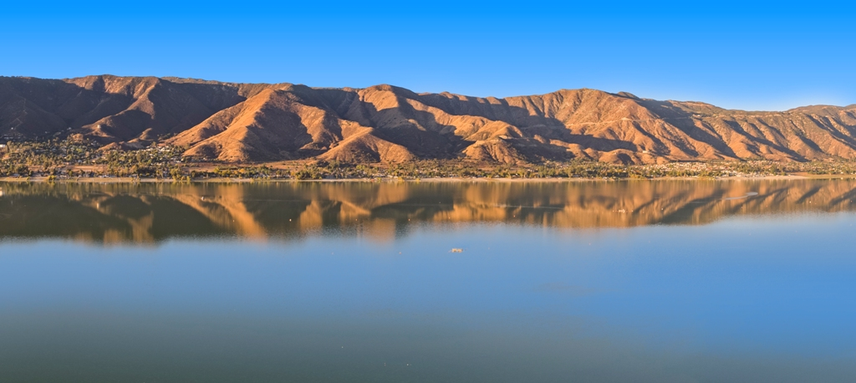
Lake Elsinore Hydro Project
2019 Winston Chung Energy Storage Technologies and Applications Conference
April 11, 2019
FERC Project No. 14227
www.leapshydro.com

Slide 2
Introduction
Science of pumped storage projects
The need for energy storage
Load balancing
The regulatory process
  Regulator scrutiny
  Timelines
  Studies
Impacts on the region
  Environment
  Transmission lines
  Firefighting
  Economy
2
FERC Project No. 14227

Slide 3
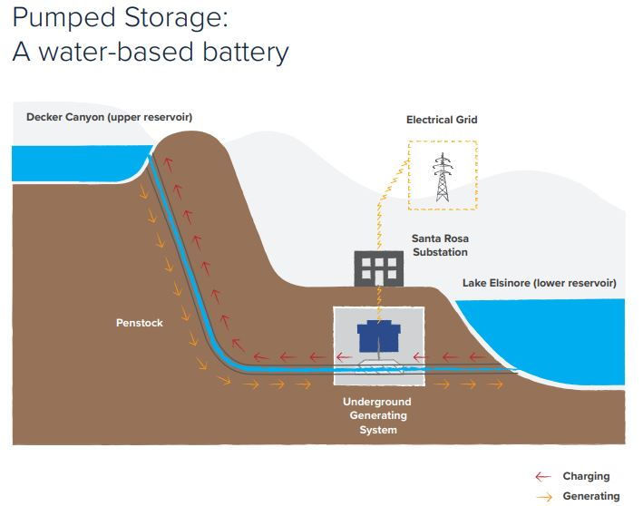
Pumped Storage
Water is pumped to an upper reservoir using low-cost off-peak power
Water in upper reservoir acts as potential energy
Water is released through turbines to generate power at times of high demand
Underground infrastructure minimizes disturbance
3
FERC Project No. 14227

Slide 4
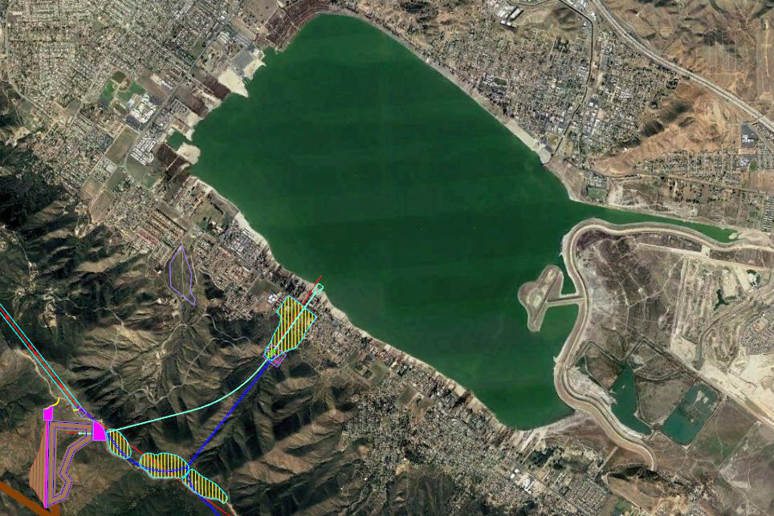
The Project
DRAFT
Consists of four primary components:
  i. Lake Elsinore - serves as the Lower Reservoir and pumped water supply
  ii. Upper Reservoir - provides transient storage of water used for generation
  Turbines/penstocks and related hydroelectric power infrastructure
  Primary transmission connection to the grid
4
FERC Project No. 14227

Slide 5
What’s New: The Need for Energy Storage
On September 10, Governor Brown signed SB 100 into law
  Calls for 100% carbon-free electricity sources by 2045
  Companion bill AB 2787 withdrawn but likely to be back calling for CA to legislate bulk energy storage projects to support reliability
The issue no longer is the transition to renewable electricity sources, it’s about storing renewable electricity for when Californians need it
Pumped storage enables better use of renewable energy and assures grid stability
  LEAPS provides the most promising large-scale energy storage and load balancing technology for the Southern California electricity grid.
5
FERC Project No. 14227

Slide 6
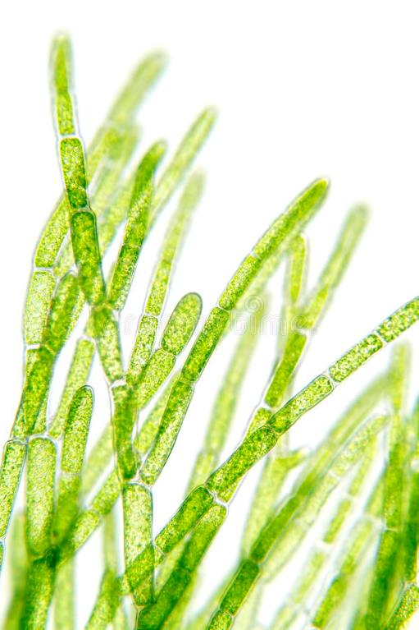
Lake Elsinore
Long term, sustainable Lake management plan
  An impaired body of water for years
  Water quality and quantity, algal overgrowth, lack of oxygenation, fish kills, and closure from recreational use
Agreement to import 15,000 acre-feet of quality water through EVMWD
  Opportunity to improve rather than just maintain
Maintaining “optimal” level of ~1,240 feet
  Role of EVMWD, City and local water authorities
  Sustainable Lake management by EVMWD, City of Lake Elsinore, LESJWA and many others
6
FERC Project No. 14227

Slide 7
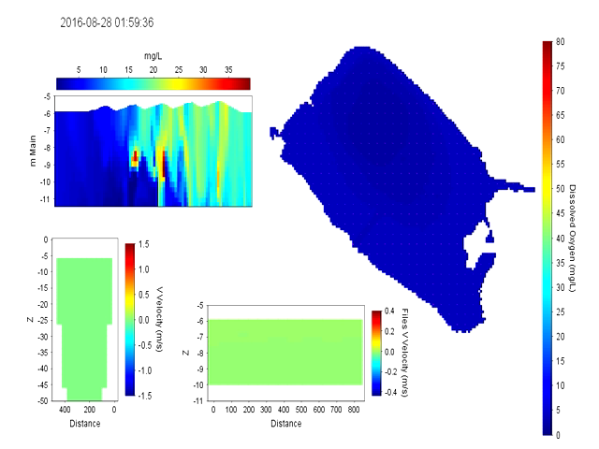
Water Quality & Quantity Studies
Assessment of project impacts on Lake Elsinore by Dr. Michael Anderson, UC Riverside
  Recently shared research and preliminary conclusions with LESJWA TMDL task force
  Complex, reliable computer model simulates project operation impacts
Importing 15,000 acre-feet of new water will help stabilize Lake levels
Higher-quality SWP water
LEAPS can deliver dissolved oxygen to bottom waters, potentially reducing fish kills
7
FERC Project No. 14227

Slide 8
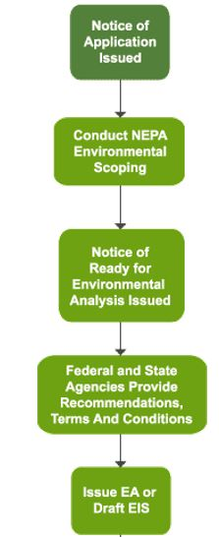
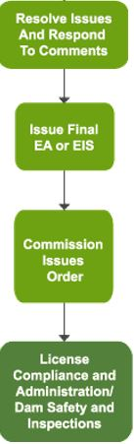
Pumped Storage Approval Process - FERC
9
FERC Project No. 14227

Slide 9
The Regulatory Process
We submitted a Final License Application in October 2017
  Project No. 14227: Significant work completed but updates required
FERC’s scientific, legal, and economic experts evaluate the environmental, cultural, geological, land use, and socioeconomic aspects of the project.
Public input requested in October 2017, and again this summer regarding studies required to be conducted/updated
In April and September, we responded to FERC’s requests for additional information and studies
FERC will solicit public input again when it accepts the license application and in response to its draft Environmental Impact Statement
8
FERC Project No. 14227

Slide 10
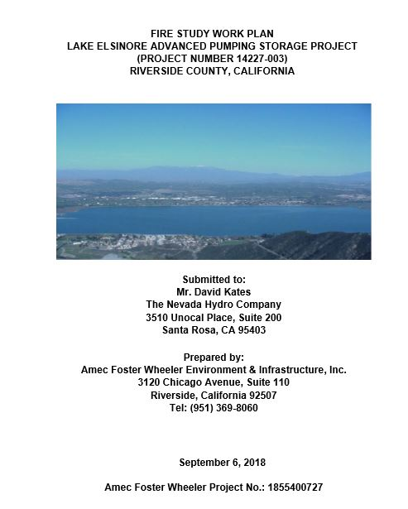
Extensive Studies and Updates Are Underway
Completed Studies
  Visual impacts
  Transmission route options
  Impacts on Lake Elsinore
  Traffic studies
Underway Studies
  Seismic and geotechnical
  Biological assessment
  Fire Risk
  Cultural Resources
10
FERC Project No. 14227

Slide 11
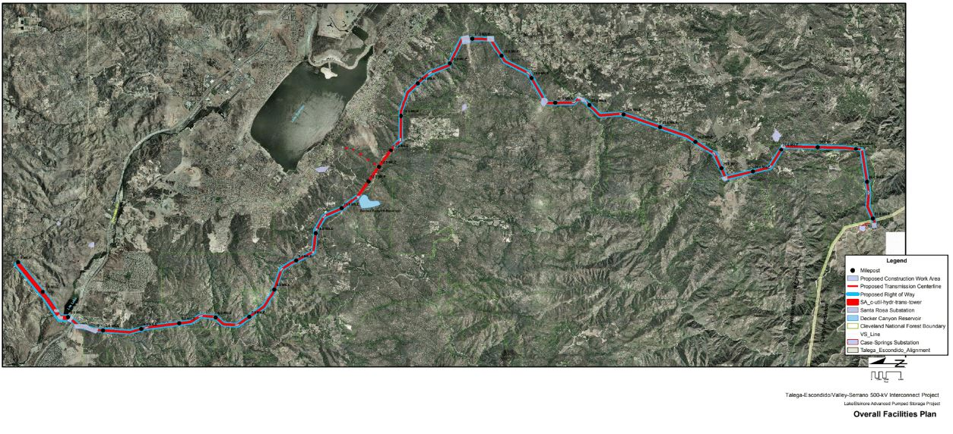
FERC Studies 30 (Visual Simulations) and 34 (Transmission) are completed
FERC directed engagement with County, City and other stakeholders
Visualization study includes transmission tower placement along some route options
12
FERC Project No. 14227

Slide 12
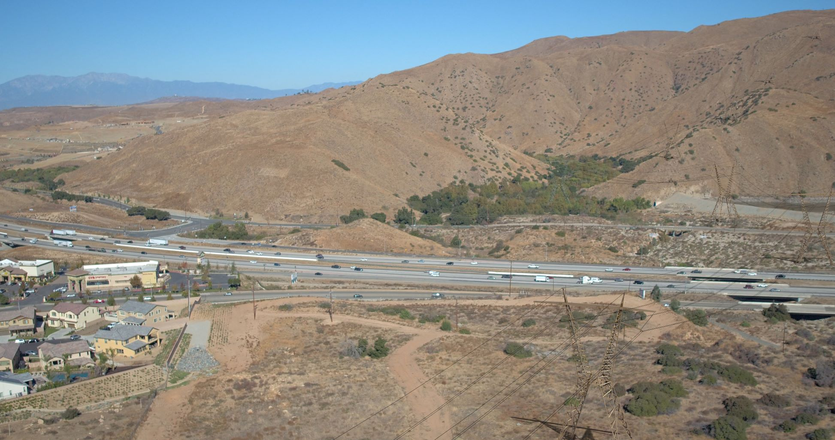
Visual Impacts
We used high resolution photography, Google Earth, and representations of existing SCE 500 kV (Temescal Valley and I-15)
Currently responding to City and County requests
Next step is to engage potentially impacted residents on some route options
13

Slide 13
Next Steps in Regulatory Process
Ongoing consultation and discussion with stakeholders and agencies
FERC responses to study plans filed and acceptance of application
FERC prepares Environmental Impact Statement (EIS) draft and final issuance
SWRCB regulatory process for issuing a draft 401 (Clean Water Act) regarding water quality certification filed after application acceptance
FERC Issuance of License
Documentation of Project Financing
Definitive Project plans and designs
Project Safety plans
Various environmental monitoring plans
14
FERC Project No. 14227

Slide 14
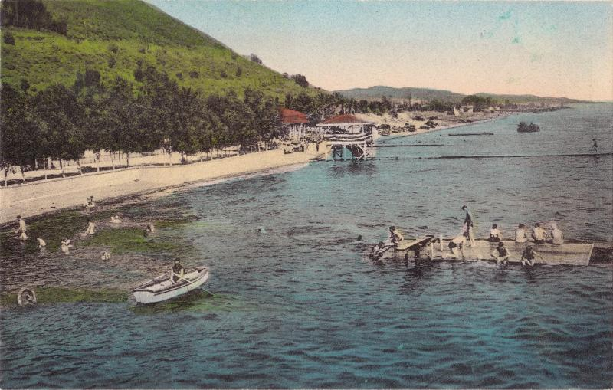
Our Commitment
To conduct our business as responsible community partners and stewards of Lake Elsinore
Contribute sustainable financial resources to the local economy
Become a good community partner
Supply sustainable renewable energy to serve quickly growing region
Assist in restoring Lake Elsinore as “the ultimate lake destination” that can be
enjoyed by residents and visitors alike…
15
FERC Project No. 14227

Slide 15
Conclusion
We appreciate the opportunity to speak with you
Working with stakeholders, this Project will
  Provide an on-going source of funding for Lake Elsinore operations
  Help stabilize lake levels
  Improve water quality
  Provide electrons when they are needed most to serve load
  Reinvest in the local economy
  Help improve the results reported in the “State of the Lake” Summit in April
16
FERC Project No. 14227

Slide 16
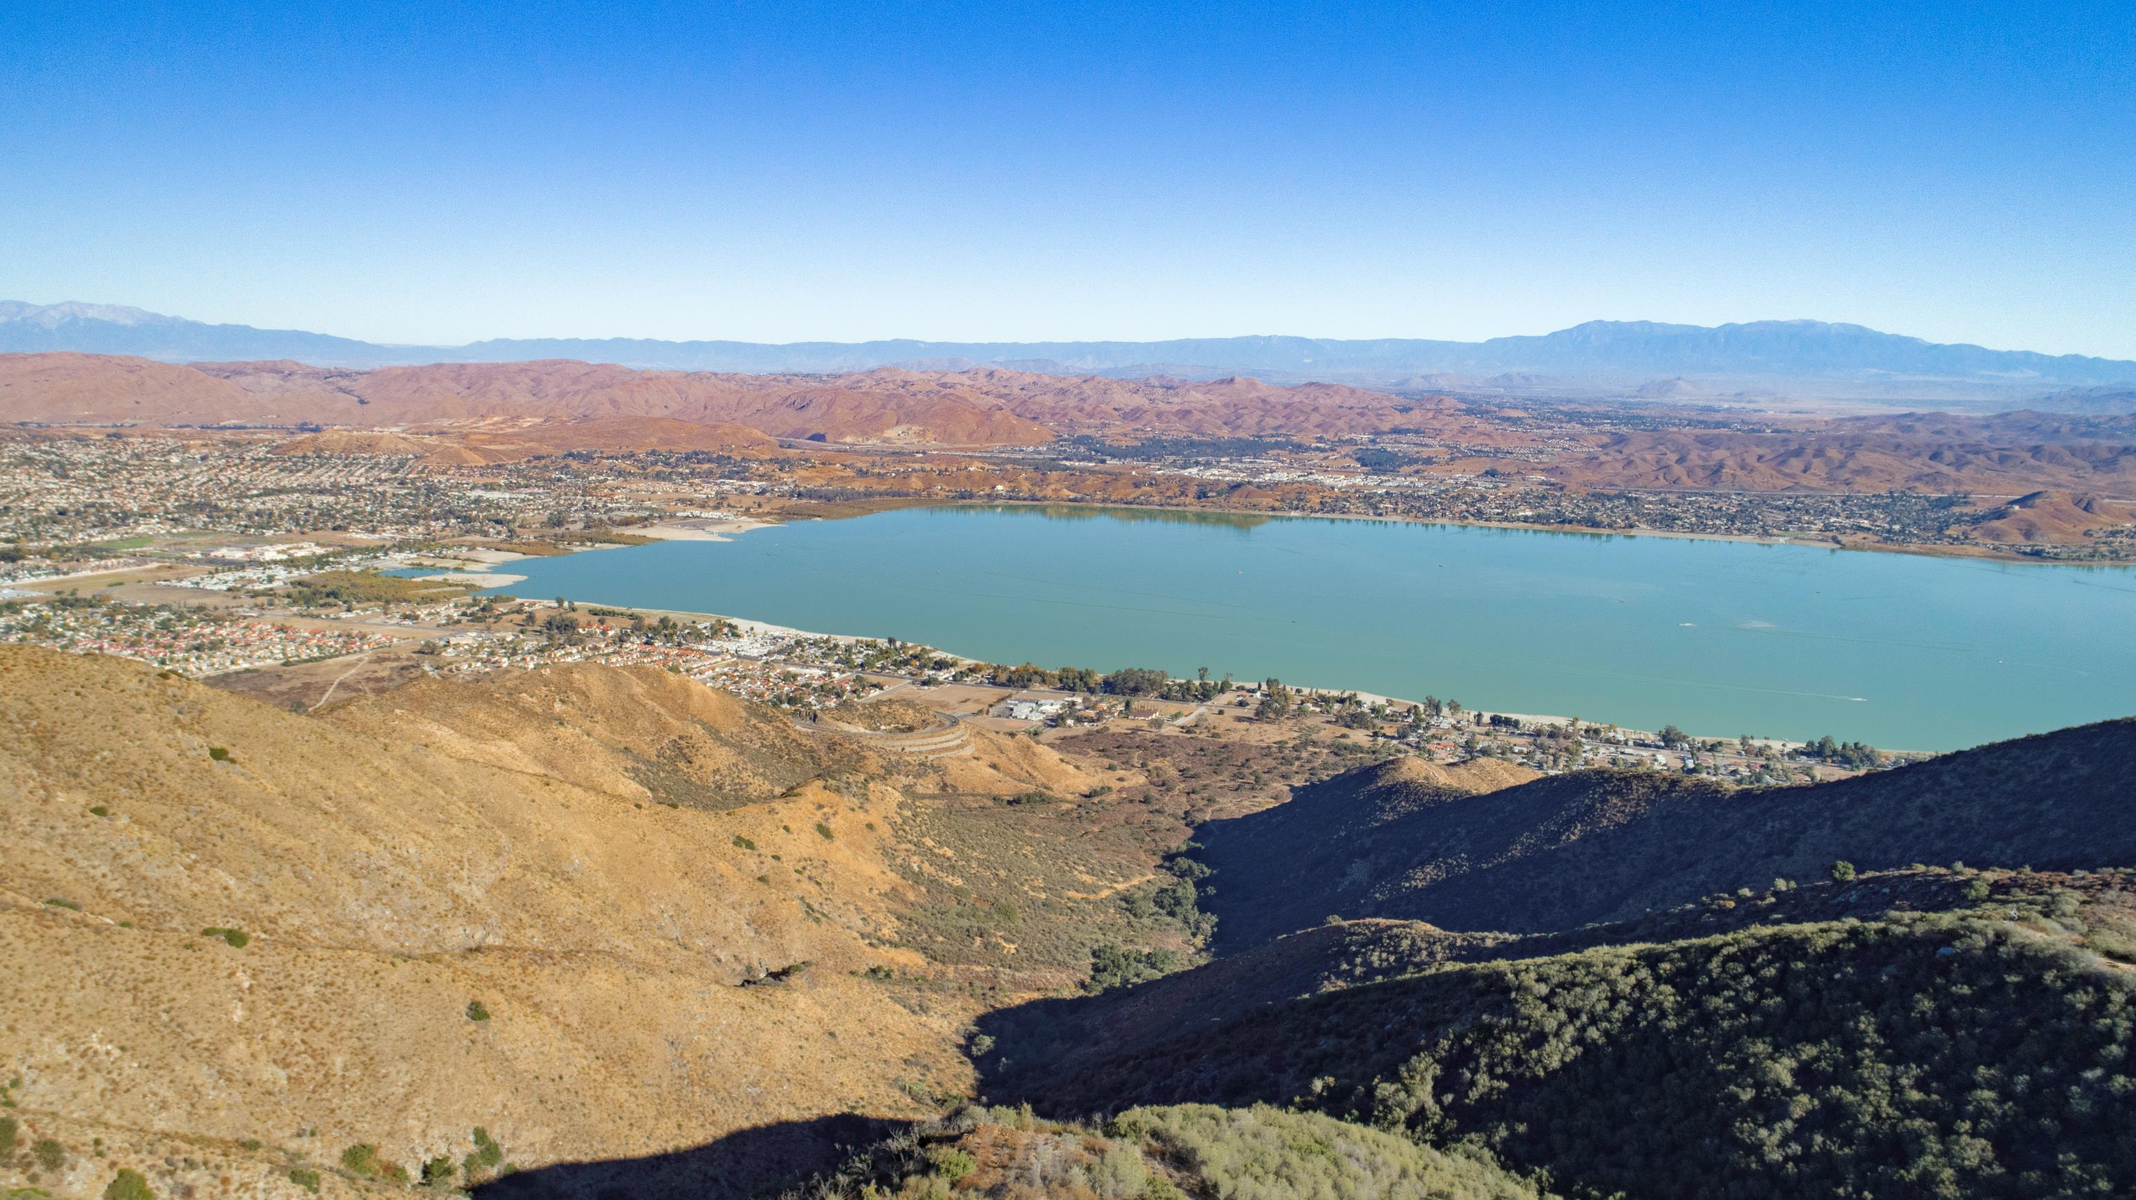
Questions?
FERC Project No. 14227

Slide 17
Rex@LeapsHydro.com
(760) 599-1813

