Slide 1
INTELLIGENT ENERGY STORAGE
For Gilroy Unified School District

Slide 2












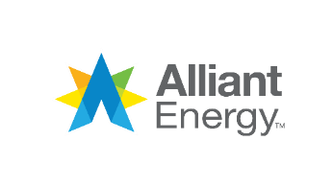






Who We Are
We help our customers save money and gain more control over energy costs with energy storage.
US Storage Division HQ in Silicon Valley
Over 150 energy storage projects
Extensive operating track record (8+ years)
2 Gigawatt Pipeline
Ranked #1 provider by Navigant Research
Key Services
  Energy Site Analysis
  & System Design
  Hardware Integration, Interconnection & Operations
  Software Service Stacking
  & Aggregation
  Performance-based Financing Options & Guarantees
Customer Examples
Businesses & Government
Utilities & Network Operators

Slide 3































Hundreds of Operating Systems

Slide 4



Distributed Energy Storage Benefits
Benefits on both sides of the meter are fueling the growth in distributed energy storage adoption.
Front-of-Meter Benefits
Behind-the-Meter Benefits
Wholesale Ancillary Services
Peak Shaving
Wholesale Capacity Services
Energy Arbitrage
Distribution Upgrade Deferral
Reliability / Microgrid
Voltage Regulation
Renewable Integration
Renewable Energy Firming
Demand Response
Generation / Load Shifting
Frequency

Slide 5

Maximizing the Value of Energy Storage
VALUE STREAMS
High School in SCE
Demand Savings
Tariff Optimization
Energy Arbitrage
Demand Response
Market Revenues*
The GridSynergy Software Platform Optimizes Across Multiple Revenue Streams to Maximize Benefits
(2.7MW / 5.4MWh across 17 sites at a CA school district)
Demand Savings | Tariff Optimization | Energy Arbitrage | Demand Response | Annual Total Benefit
$207,908 | $144,997 | $81,355 | $42,660 | $476,920
44% | 31% | 17% | 9% | -
*Future Upside

Slide 6


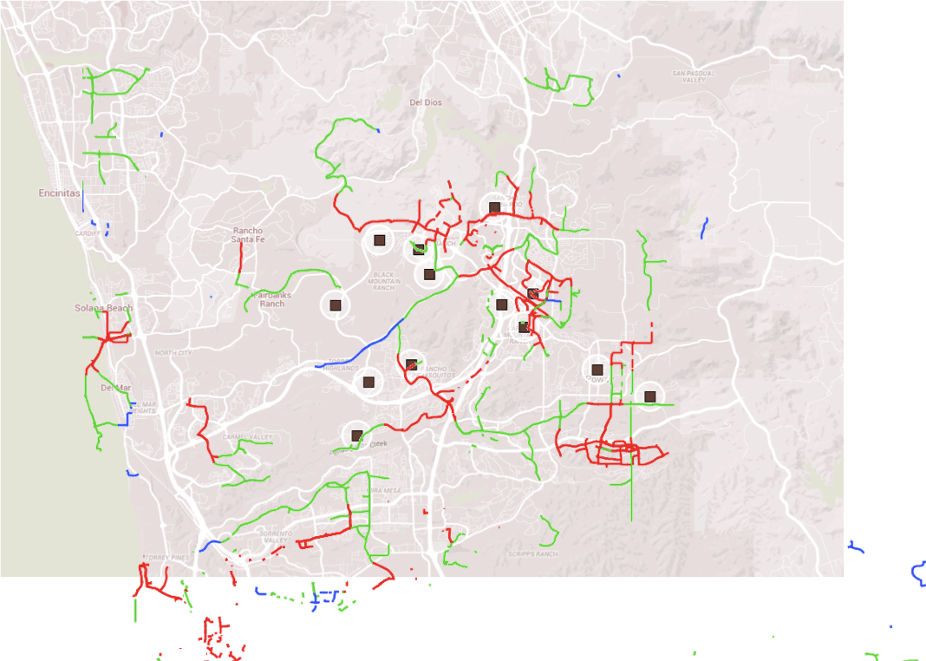
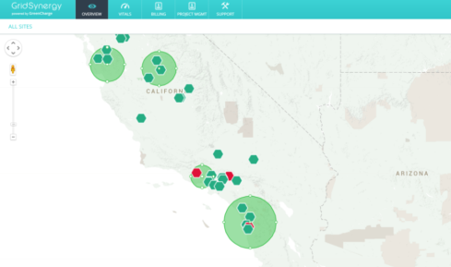
Case Study: San Diego Gas & Electric
ENGIE STORAGE SOLUTION
Sourced 30 distributed ESS hosts to develop an aggregated portfolio of 15 MWh for feeder-specific peak demand relief
Systems
VPP Size
VPP Aggregation and Control
40
14,400kWh
Engie Storage aggregation into single resource for utility dispatch
Engie Storage GridSynergyTM Master Command and Control
Modules utilized:
Virtual Aggregation
Feeder / Circuit Relief
Renewable & Load Shifting
Optimizer
Notes:
Details of SDG&E condition:
Severe feeder overstress requiring multi-MW of relief during peak times
High penetration of solar causing ramp rate control issues for grid operators

Slide 7
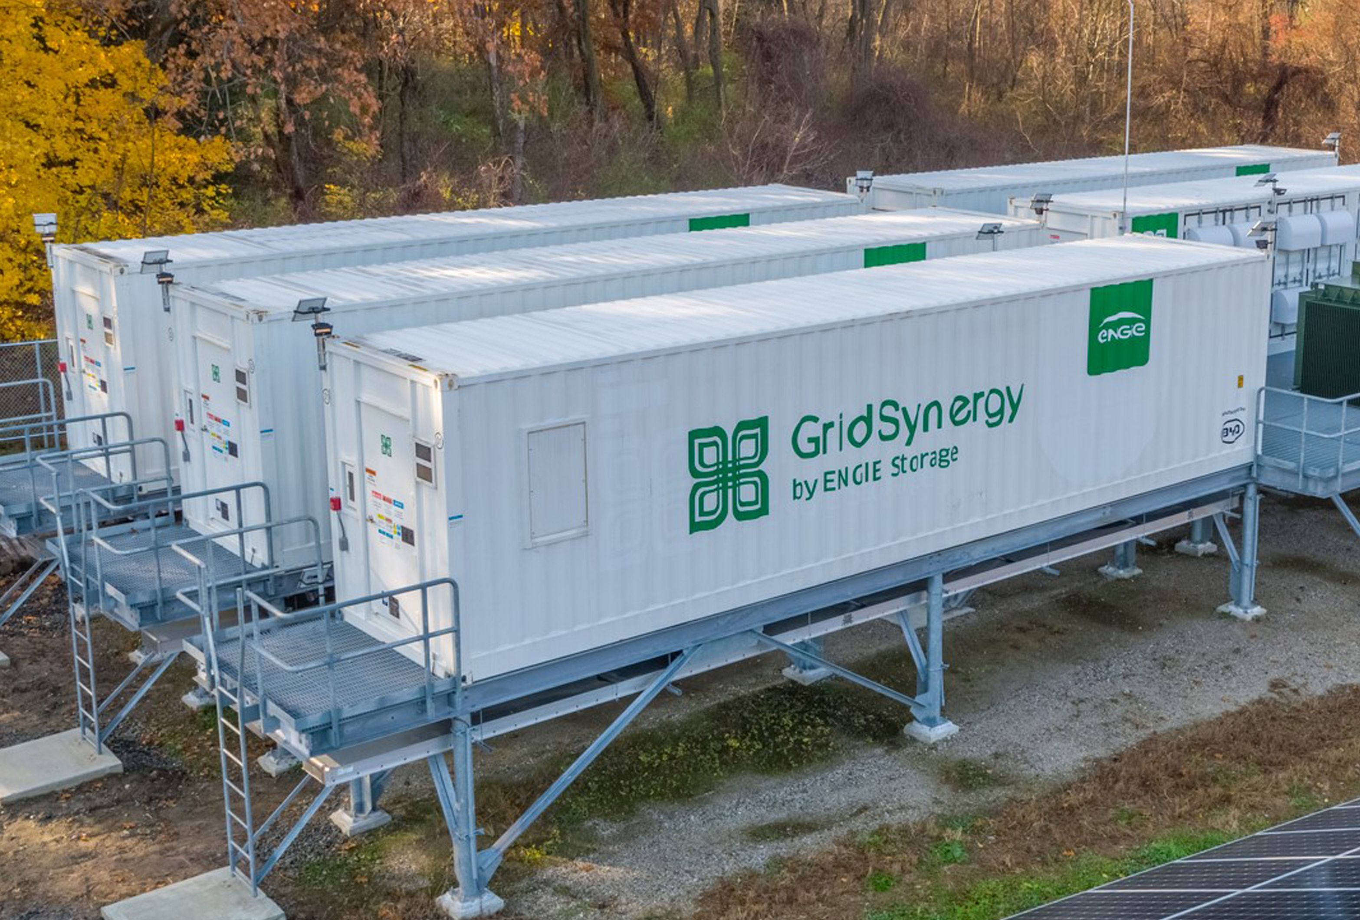
Holyoke Gas and Electric
Service Area: Northeastern U.S.
Size: 3 MW / 6 MWh
Customer Challenge
High annual coincidental peak demand charges
ENGIE Storage Solution
Design, finance, supply, and install an energy storage system to work with a solar PV system. 20-year commitment to operate system and integrate controls with HG&E’s asset control and monitoring system.
Services
Coincidental Peak Demand Shaving
Solar firming
Capacity
“
HG&E is pleased to work with ENGIE on this project which expands our portfolio of low-cost renewable energy, and helps us maintain some of the lowest electric rates in the region.”
– James M. Lavelle, Manager

Slide 8
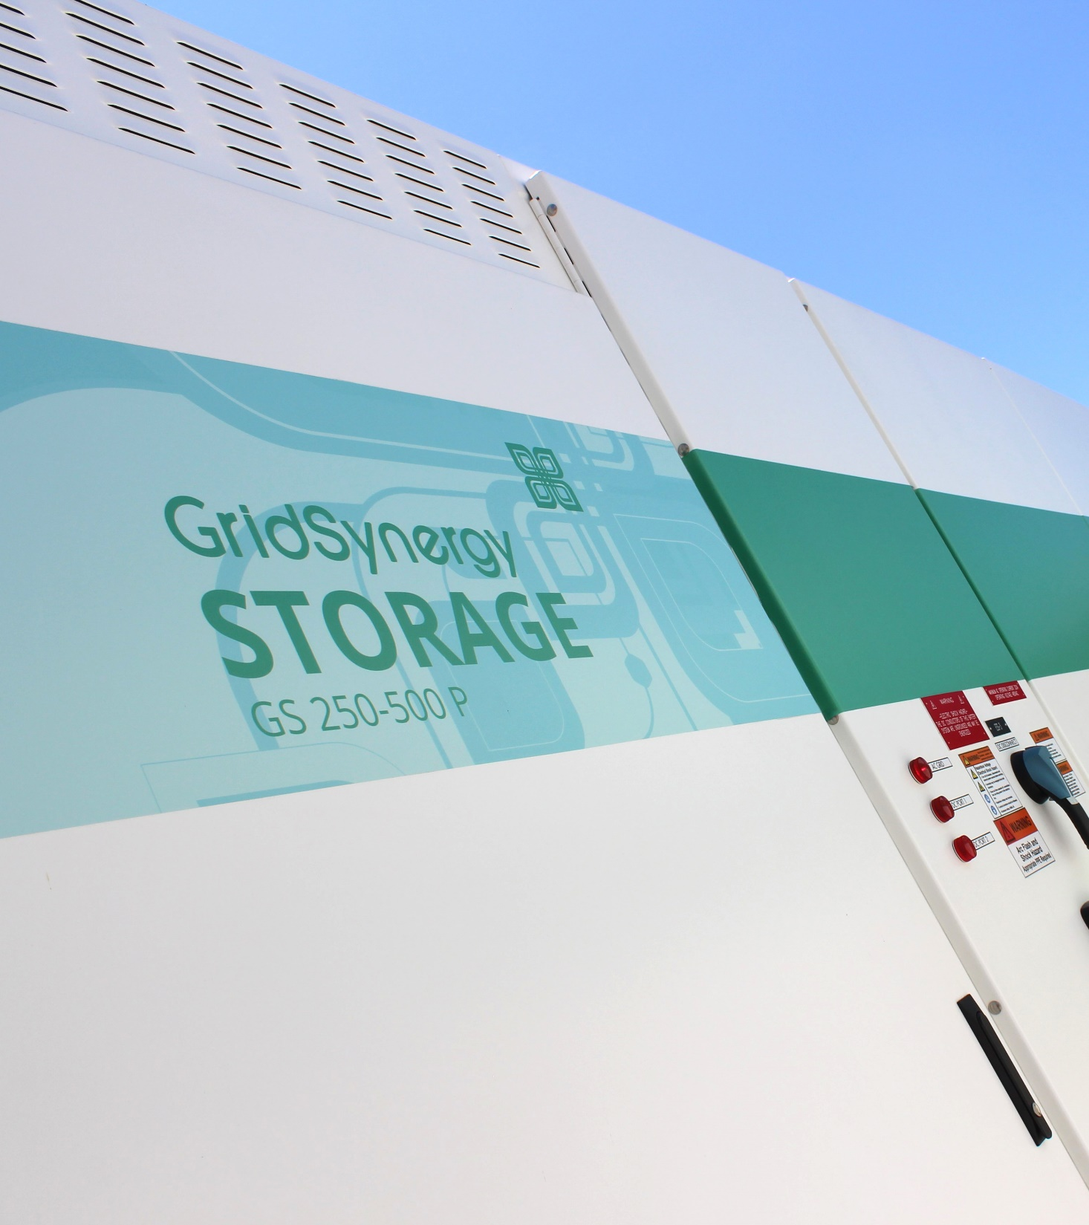
Questions?

