Slide 1


Bourns® Components for Battery Management Systems (BMS)
Innovative solutions that enhance safety and extend battery life
Achilles Chiotis, Ph.D.
VP Consumer Segment
Bourns, Inc.

Slide 2

Agenda
A brief history of batteries
Reasons for current dominant position of Li-ion
Li-ion global market breakdown and battery construction basics
Benefits of Battery Management Systems (BMS)
Bourns' innovative solutions for BMS designs

Slide 3














A Brief History Lesson
1800s
Mid-1900s
Late 1900s
2000s
1980 – John Goodenough
invents lithium-ion battery
1859 – Gaston Plante
Invents lead acid battery
2016 – Tesla Gigafactory starts operation
1985 – Asahi Chemical, A Yoshino patents carbon anodes
1976 – Exxon invents
lithium titanium disulfide
battery
1899 - Waldemar Jungner
invents nickel cadmium battery
2008 – Tesla launches its Roadster
1950s – US funds
battery research
2006 – Year of lithium battery recall
1900 – 30% of all cars produced in US are electric
1989 – 1st commercial NiMH batteries released
2000 – Li-ion overtook NiMH and NiCD in rechargeable battery market
1908 – Ford launches
Model T
1991 – Sony launches 1st
lithium-ion battery

Slide 4
Reasons for Current Dominant Position of Li-Ion
Many significant advantages such as high energy density and low weight.
Shortcomings can be managed with effective battery management systems (BMS).
Advantages
Disadvantages
High energy density (900 KJ/Kg)
No memory effect / low maintenance
Environmentally safe
Low molecular weight / lightweight
No degradation issues
Mechanically stable (not sensitive to mechanical shock)
High cycle life
Charge retention (loses ~ 5% / month)
Limited life span ~ 3 years
Degrades faster when exposed to heat
Ruined if completely discharged
Requires protection circuit to maintain voltage and current within safe limits
Transportation restrictions
Expensive to manufacture
Not fully mature, metals and chemicals are changing on a continual basis

Slide 5
Global Li-Ion Battery Market
Source: Avicenne Energy 2016

Slide 6
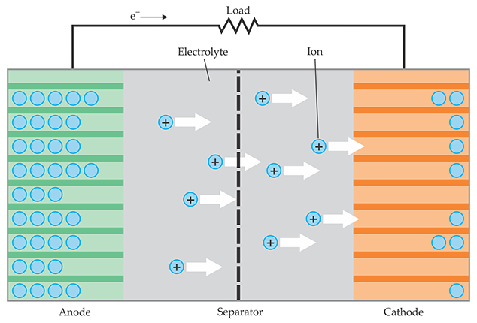
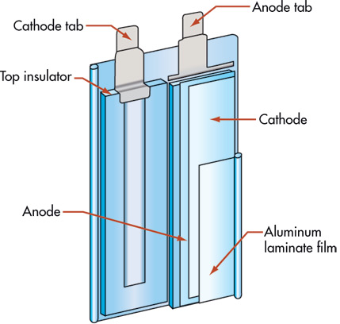
What Exactly is a Lithium-Ion Battery?
Liquid or gel. lithium salt in organic solvent
Graphite-based with some silicon
Polyolefin (polyethylene, polypropylene)
Various formulations, lithium cobalt oxide (LCO) most common
Lithium-Ion batteries are sometimes called “rocking chair batteries” as the charge shuttles back and forth between two intercalating electrodes during charging and discharging.

Slide 7
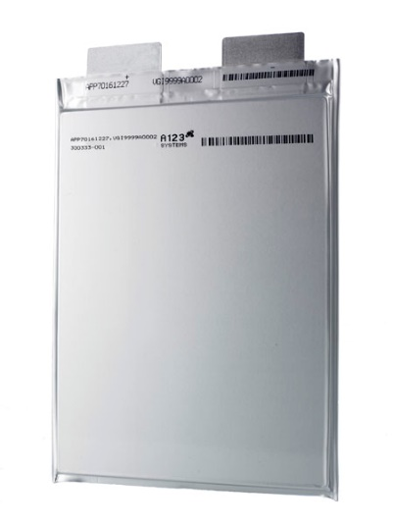
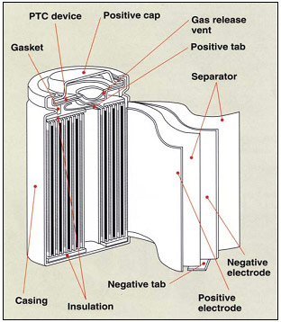
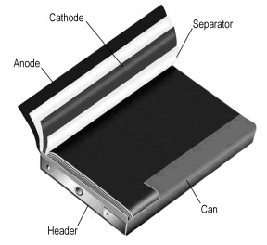
Common Li-Ion Battery Cell Types
Cylindrical Cells
Prismatic Cells
Pouch Cells
Good cycling ability / long calendar life / economical
Heavy / low packaging density
Improves space utilization / allows flexible design
More expensive to manufacture / less efficient in thermal management / shorter cycle life / allows for some swelling
Most efficient use of space/ eliminates metal enclosure to reduce weight
Cell needs support and allowance to expand

Slide 8
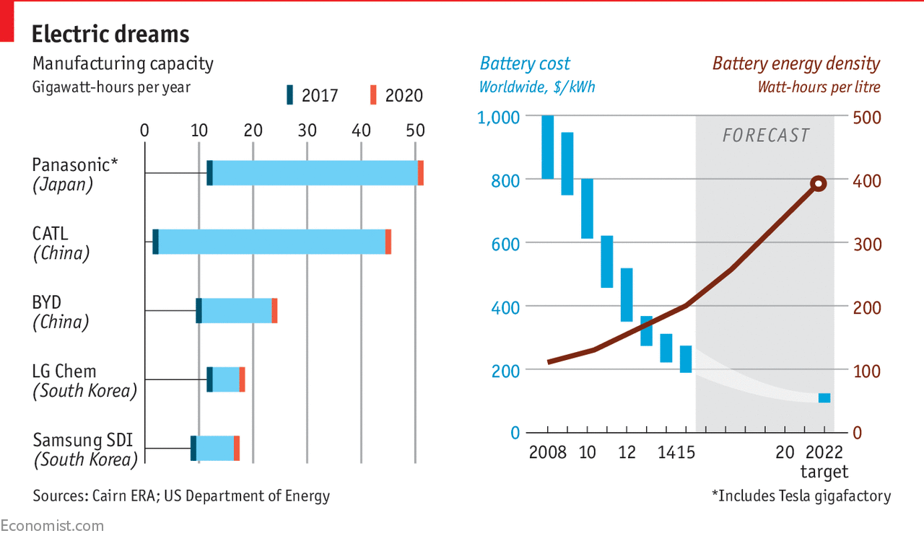
Forecasted Manufacturing Economies of Scale

Slide 9
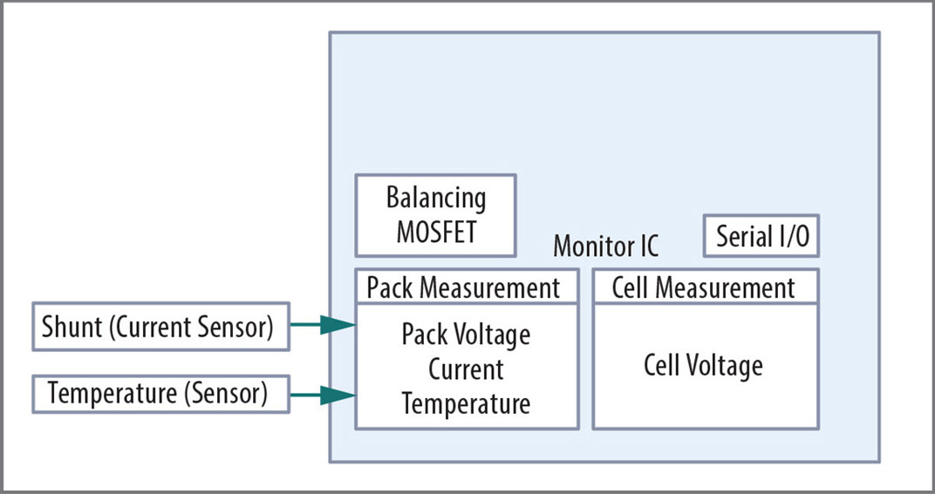
Battery Management Systems (BMS)
Battery management system connects to high energy battery packs and performs four major functions: Monitor, balance, protect and communicate
  Monitor: Voltage, current, temperature, state of charge (SoC), state of health (SoH)
  Balance: Individual cell voltages are balanced for maximum battery pack efficiency
  Protect: Overcurrent, overvoltage, overtemperature events
  Communicate: CANbus and/or wireless communication protocols
Block diagram of BMS IC

Slide 10

Bourns' Innovative BMS Solutions
Four major Bourns product lines are involved:
  Transformers
    Reliable AEC-Q200 compliant isolation transformers
  Current sensing resistors
    AEC-Q200 compliant shunt resistors
  Semiconductor protectors
    Discrete devices designed to protect sensitive monitoring ICs from faulty conditions
  Thermal Cutoff devices (TCO)
    Bimetal/PTC hybrid devices providing overtemperature and overcurrent protection
    Designed for consumer portable electronics applications
      Laptops, tablets, smartphones, digital cameras, battery powered home appliances
Users should verify actual device performance in their specific applications.

Slide 11
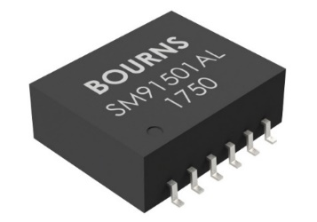
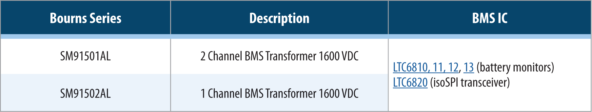
BMS Transformers for Isolated Communications in High Voltage BMS
Bourns engineered a series of BMS transformers
  Developed for best protection for isolated communication in high voltage BMS
  Meeting high voltage requirements for high-voltage BMS (>1 KV)
  Wide operating temperature range of –40 °C to +125 °C
  Qualified to work together with ADI and NXP BMS ICs
  AEC-Q200 compliant
  Provides protection of the communication line from hazardous voltages coming from the battery pack, up to rated limits

Slide 12
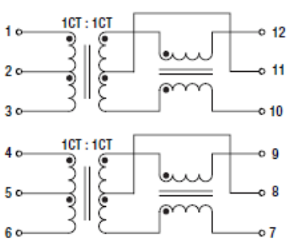
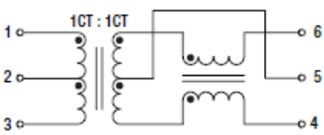
BMS by Daisy Chain
Battery Monitor
Battery Monitor
SM91501AL-Dual
Battery Monitor
BMS
Controller
SM91502AL-Single

Slide 13
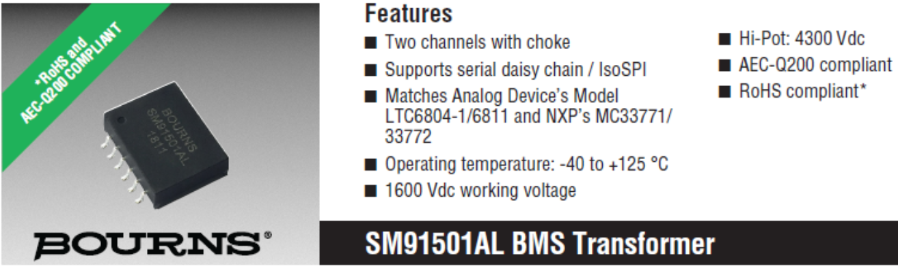
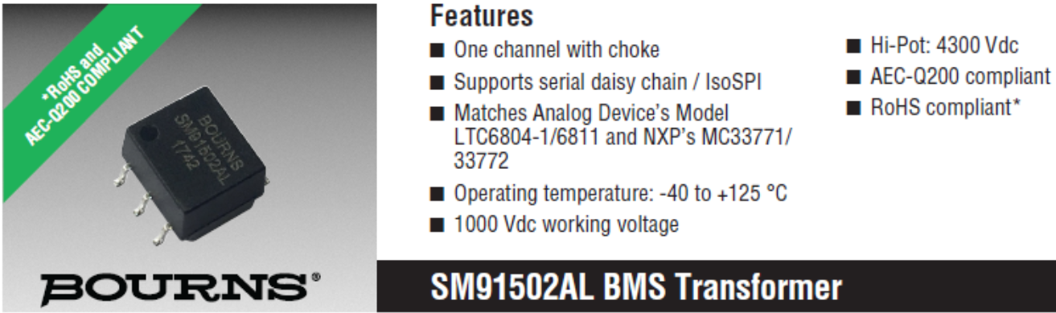
BMS Transformers - High Isolation Voltage
Applications:
High-energy BMS
Backup Battery Systems
Grid Energy Storage
High Power Portable Equipment

Slide 14
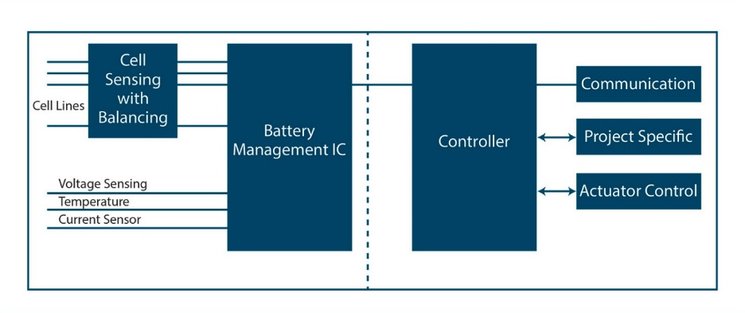
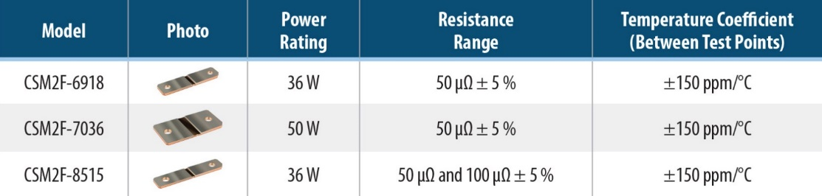
BMS Shunt Resistors for Harsh Environments
Bourns offers three ultra-low resistance shunt resistor models for accurate current sensing
AEC-Q200 compliant and produced in an IATF approved facility
Tin-plated terminals
50 µΩ or 100 µΩ resistance values
Customization capability

Slide 15
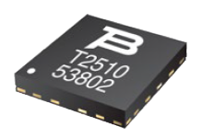
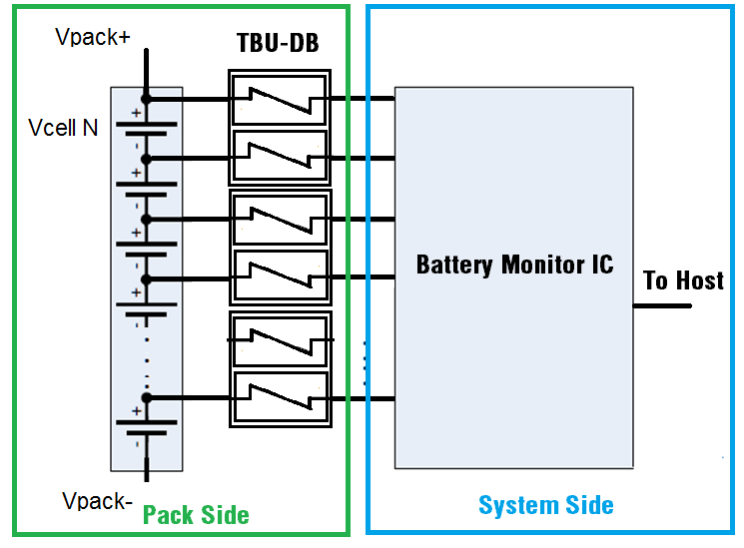
TBU® High-Speed Protectors for Cell Monitoring IC Protection in Automotive BMS
Bourns developed and introduced a unique, proprietary semiconductor series, TBU-DB-Q, to protect sensitive cell monitoring ICs from faulty conditions
AEC-Q101 compliant
TBU-DB-Q

Slide 16
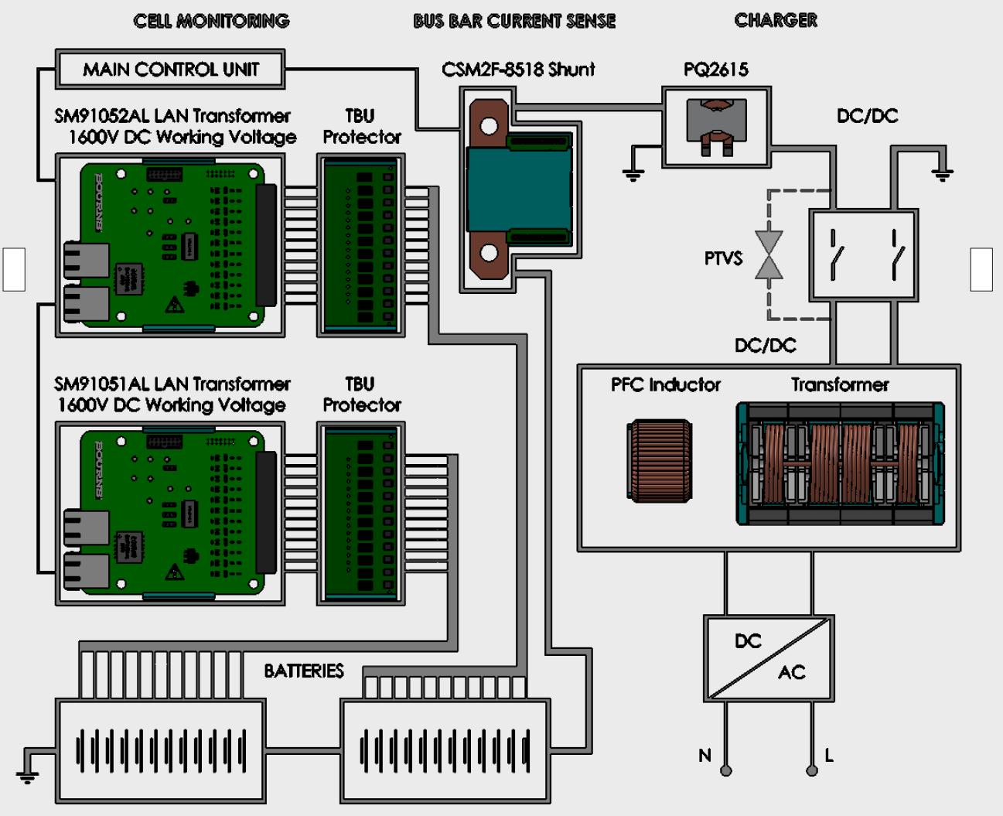

Bourns® Components Help to Ensure BMS Safety and Long Life

Slide 17
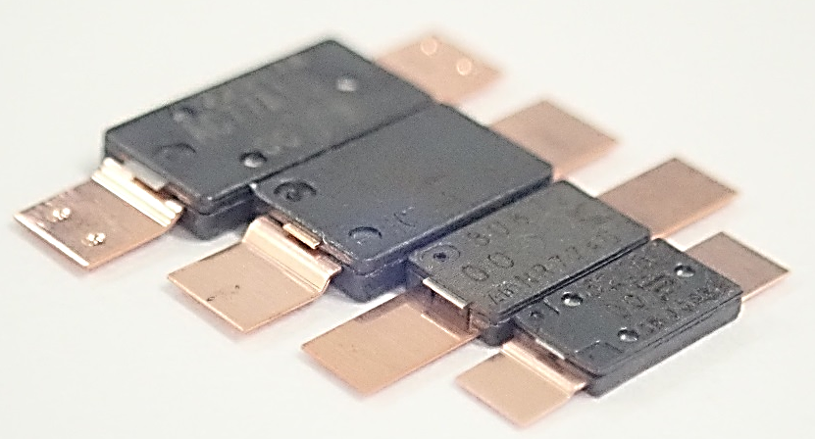
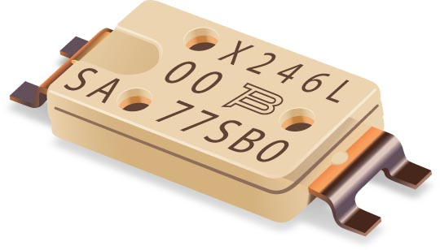
Mini-breaker TCO Devices for Overtemperature and Overcurrent Protection in Portable Consumer Electronics
Mini-breakers are designed to protect batteries in consumer electronics such as laptops, tablets, smartphones, digital cameras and battery powered home appliances
They are also designed to protect power delivery USB cables
UL and TÜV listed
Mini-breakers are designed to stay tripped during abnormal temperatures, and then recover when power is cut and the temperature returns to a safe level

Slide 18
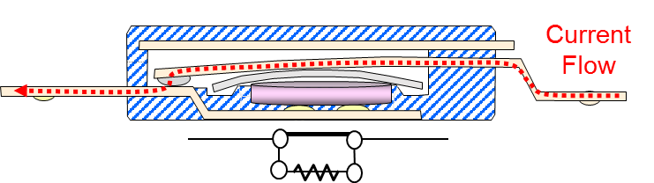
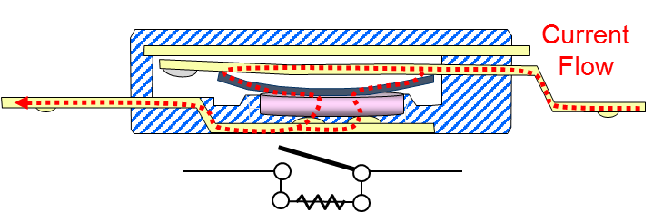
Mini-breaker TCO Devices - How they Work
A single device that provides overtemperature and overcurrent protection
Contact
Cover
Cover plate
Arm
Base terminal
Arm terminal
PTC
Base
Bimetal disc
Normal Operation
Trip Condition
When the environmental temperature rises and/or an excessive current flows through the arm, the bimetal disc heats.
The heat reverses the bimetal disc to lift the arm to the open position.
At this points, the current shunts to the PTC and heats it up to keep the bimetal disc open and in a latched position until fault is removed.

Slide 19

Mini-breaker - How it works (Video)

Slide 20
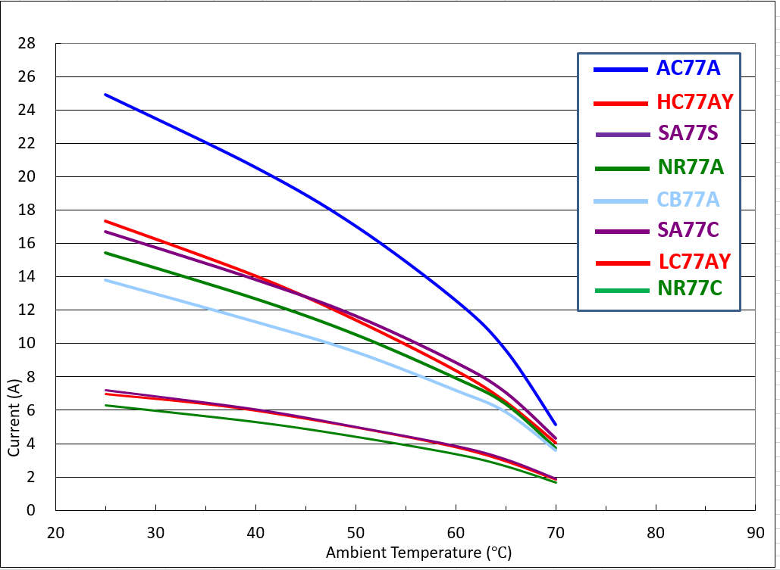
Mini-breaker TCO Device Line-up
Series | LC | HC | AA/AC | NR |  | CB | SA |  | SC
Type |  |  |  | C | A | A | C | S | A
Trip temperature | 72,77,82,85 | 72,77,82,85,90 | 72, 77,82,85,90 | 72,77,82,85 | 72,77,82,85 | 72,77,82,85 | 72,77,82,85 | 72,77,82,85 | 72,77,82,85
Contact Rating | DC9V/12A | DC9V/25A | DC9V/35A | DC12V/12A | DC12V/25A | DC9V/25A | DC9V/12A | DC9V/25A | DC9V/25A
Max. breaking current (100 cycles) | DC5V/40A | DC5V/80A | DC5V/60A | DC5V/30A | DC5V/60A | DC5V/50A | DC5V/30A | DC5V/60A | DC5V/50A
Max. voltage (100 cycles) | DC28V/5A | DC28V/25A | DC28V,35A | DC28V/12A | DC28V/25A | DC28V/25A | DC28V/12A | DC28V/25A | DC28V/25A
Self hold min. voltage (at 25℃) | 2V | 3V | 3.5V | 2V | 2V | 3V | 3V | 3V | 3V
Max. leak current | 150mA | 200mA | 200mA | 150mA | 200mA | 200mA | 200mA | 200mA | 200mA
Resistance (Max) | 15mΩ | 5mΩ | 2mΩ | 15mΩ | 5mΩ | 6mΩ | 15mΩ | 7mΩ | 7mΩ
Current v Temperature Curve.
25A
LC/HC – highest volume product
AC – highest current device
NR – smallest device on the market
CB – next generation of NR
SA – first SMD device on the market
SC – smallest SMD device
17A
15A
13A
12A
8A
7A
4A
Notes:
20

Slide 21

Conclusions
Lithium-ion batteries dominate the battery market today. Significant investments are underway to further improve performance and safety and to reduce cost. New materials, especially electrolytes, are being developed.
Lithium-ion battery market expanded significantly from traditional 3C applications (computer, camera, communications) to large size, high-energy systems for automotive and industrial applications over the last 10 years.
Lithium-ion batteries need Battery Management Systems (BMS) to perform safely within their Safety Operating Area (SOA).
Leveraging the company's extensive power electronics experience, Bourns offers multiple innovative component solutions for high energy and industrial BMS. Designed to monitor, protect and effectively manage power conversion, Bourns® components help make BMS safer and more reliable.
Bourns also has proven devices that help protect Li-ion batteries in consumer applications.
Bourns is largely recognized as a global and innovative leader in BMS.
Bourns continues to invest into R&D for additional BMS components based on evolving customer needs.

Slide 22
Thank you!
Thank you!

