Slide 1
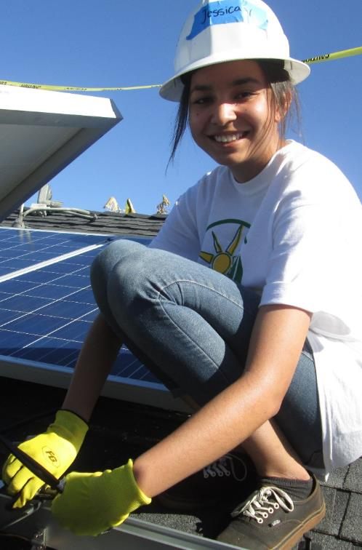
Building Community,
One Rooftop at a Time
A. Bambi Tran, Vice President, Regions
btran@gridalternatives.org | 951-471-7045 | gridalternatives.org

Slide 2
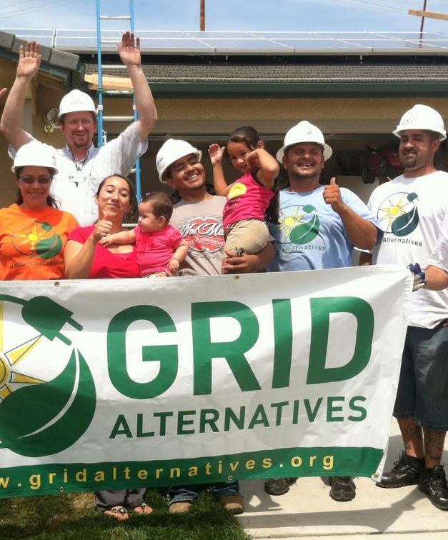
GRID Alternatives
Nation’s Largest Solar Non-Profit
  9 Regional Affiliates Across the US (CA, CO, DC/Mid-Atlantic)
  Total of 49 megawatts of solar installed
Provides Solar Solutions for Underserved Communities
  Over 11,500 solar projects installed for low-income residents throughout the country
Workforce Development and Volunteerism Model
  Over 40,000 individuals have been provided with hands-on training
Economic and Environmental Benefits
  Generate over $345 million worth of clean, renewable power
  Eliminate over 854,000 tons of greenhouse gas emissions
A. Bambi Tran, Vice President, Regions, GRID Alternatives
btran@gridalternatives.org | 951-471-7045 | gridalternatives.org

Slide 3


Slide 4
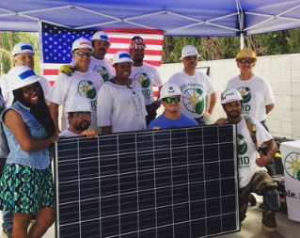
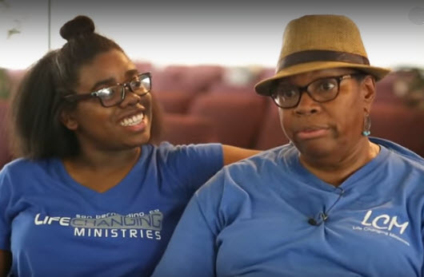
Pat &
Sarah
A. Bambi Tran, Vice President, Regions, GRID Alternatives
btran@gridalternatives.org | 951-471-7045 | gridalternatives.org

Slide 5
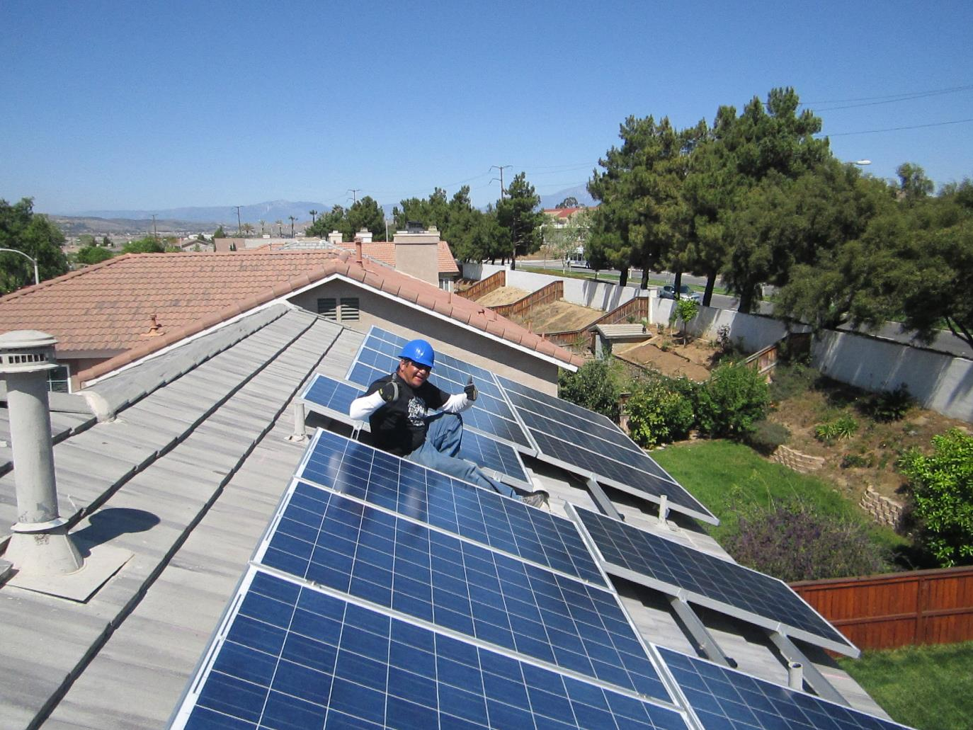
Pancho
A. Bambi Tran, Vice President, Regions, GRID Alternatives
btran@gridalternatives.org | 951-471-7045 | gridalternatives.org

Slide 6
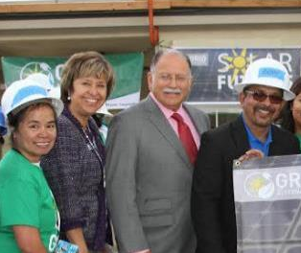
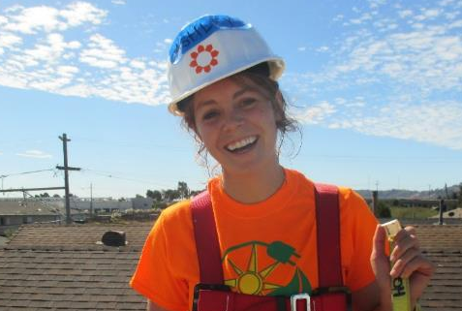
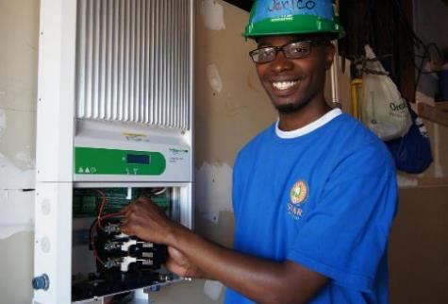
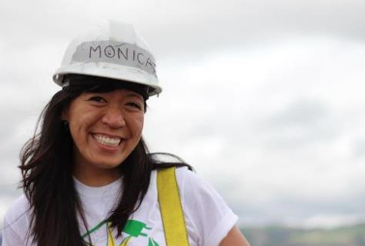
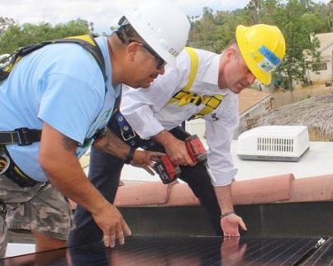
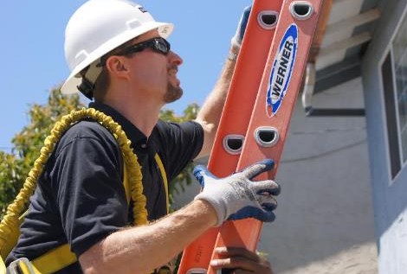

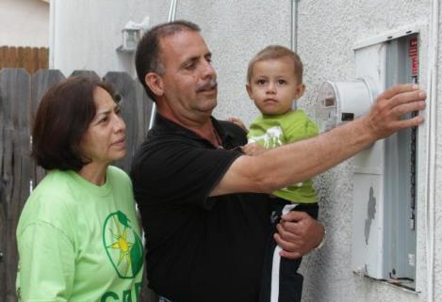
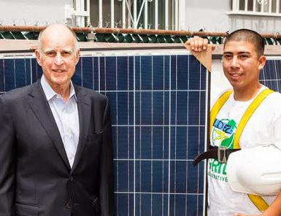
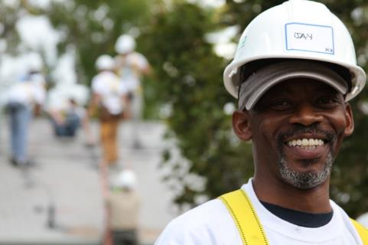
The GRID Community
Team Leaders
Job Trainees
Community Members & Leaders
Industry Leaders
Corporate Volunteers
Clients
Policymakers & Researchers
A. Bambi Tran, Vice President, Regions, GRID Alternatives
btran@gridalternatives.org | 951-471-7045 | gridalternatives.org
Notes:
GRID Alternatives incorporates a barn raising model to get our work done. We have folks from a variety of backgrounds, intentions and motivations coming together on an install. Here are some examples (compare to answers sin room) and mention there are other people to note, like Veterans, women’s groups, student/youth groups, etc (as mentioned earlier). This can be a great learning opportunity as you learn from different volunteer/trainee’s backgrounds and working styles, networking opportunity if you’re looking for a job – you never know who you may meet on a job site, etc.
Another fun fact: this Corporate Volunteer is actually Tom Werner, CEO of SunPower

Slide 7
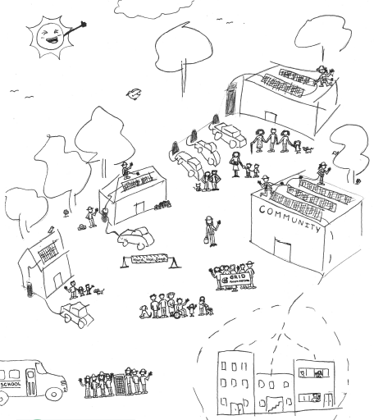
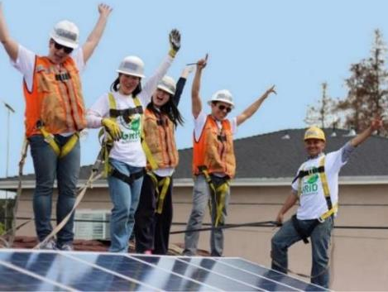
GRID’s Vision…
a successful transition to clean, renewable energy that includes everyone
A. Bambi Tran, Vice President, Regions, GRID Alternatives
btran@gridalternatives.org | 951-471-7045 | gridalternatives.org

Slide 8

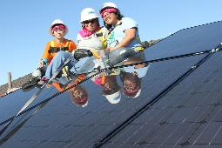
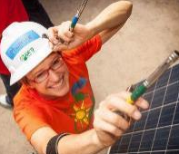
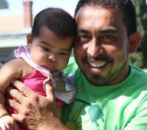
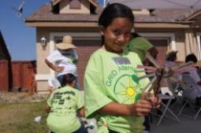
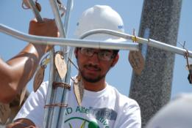
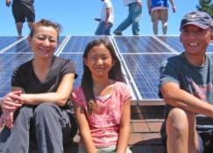
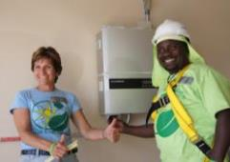


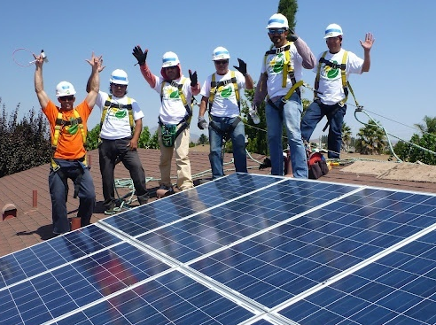
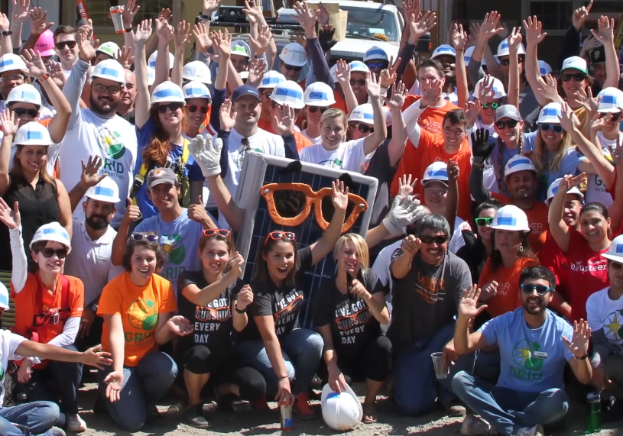
Thank You & Questions
A. Bambi Tran, Vice President, Regions
951-471-7045
btran@gridalternatives.org
gridalternatives.org

