Slide 1

Device-level modeling of Battery Energy Storage Systems in Grid-Tied Operation
Presneted by: Hossein Akhavan-Hejazi

Slide 2
Battery Control for Building Peak Load Reduction
About
The Bourns building 1200 includes typical electrical load consisting of air conditioners, office equipment, lighting, refrigerators, computers, and other plug loads. However, there are also laboratory and testing processes that comprise short periods of peak electric demand. There is a significant potential for electrical saving when a user can manage to reduce this monthly peak.
Sample Building Net Load at Bourns 1200 in May 2017

Slide 3
Battery Control for Peak Load Reduction
Summary
The current optimization algorithms for operation management of grid-tied battery energy storage systems (BESS) typically do not look much under the hood of the BESS, i.e. the device-level characteristics of the batteries. In this project we propose approaches to overcome the complexities of detailed modelling of batteries in BESS operation optimization. Features such as cell-to-cell variations in (a) maximum capacity, (b) charge level balance, and (c) internal resistance are addressed. We account for the individual cells forming the battery pack via equivalent circuit representation of each cell.
100
(a)
75
50
25
0
-25
Battery 1, BMS reported Battery 2, BMS reported Battery 1&2, Estimated
Power (kW)
The questions is: what level of details in battery / energy storage modeling should we consider from operation and integration perspective?
Event 1 Discharge Halt
12
14
16
18
20
100
(b)
Unexpected SoC Drop
SoC (%)
75
50
25
0
-25
12
14
16
Time (Hour)
18
20

Slide 4
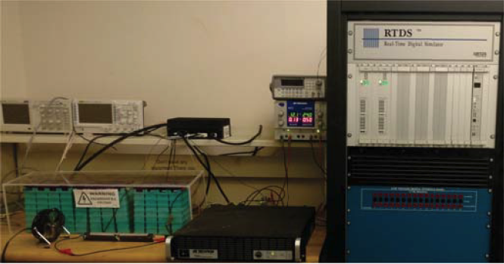
Power Hardware-in-Loop Battery Test System
About
The accurate modeling of battery energy storage systems is particularly challenging, as their response is dependent on the inverter characteristics and the controls applied, as well as to the battery cells and their dynamics. P-HIL modeling of grid-connected battery energy storage systems allows us to accurately analyze and capture several features that would be very difficult to see with numerical modeling. The P-HIL testbed developed in this project realizes a battery system with both active and reactive power capability and provides several key advantages for testing and analysis.

Slide 5
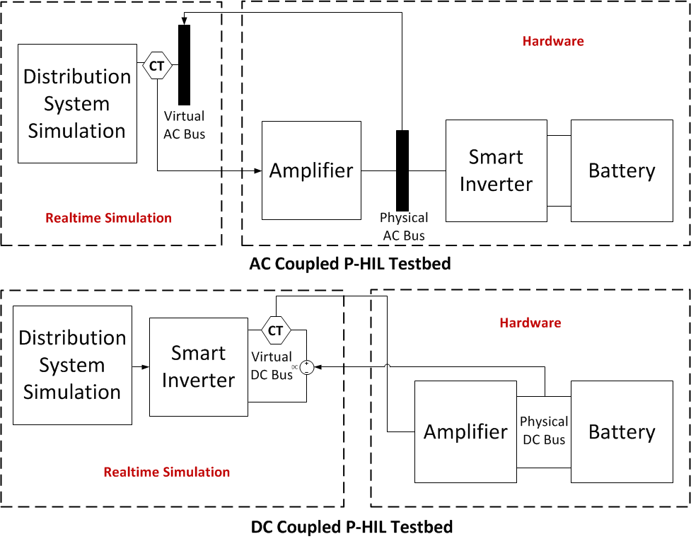
Power Hardware-in-Loop Battery Test System
The Challenge
A challenge to establishing a complete P-HIL testbed is the effective interconnection of the hardware components and the simulation environment so that the testbed allows for flexible operation/control and accurate results.
A typical approach involves coupling of BESS hardware components and RTDS at AC node, and requires the hardware for smart inverter, which limits control capabilities, and increases cost.
The alternative proposed here is to couple the BESS at the DC node, so that to include a detailed model of the smart inverter and connect to the battery cells and BMS hardware, where the models are lacking accuracy.
AC Coupled P-HIL versus DC Coupled P-HIL Testbed

Slide 6
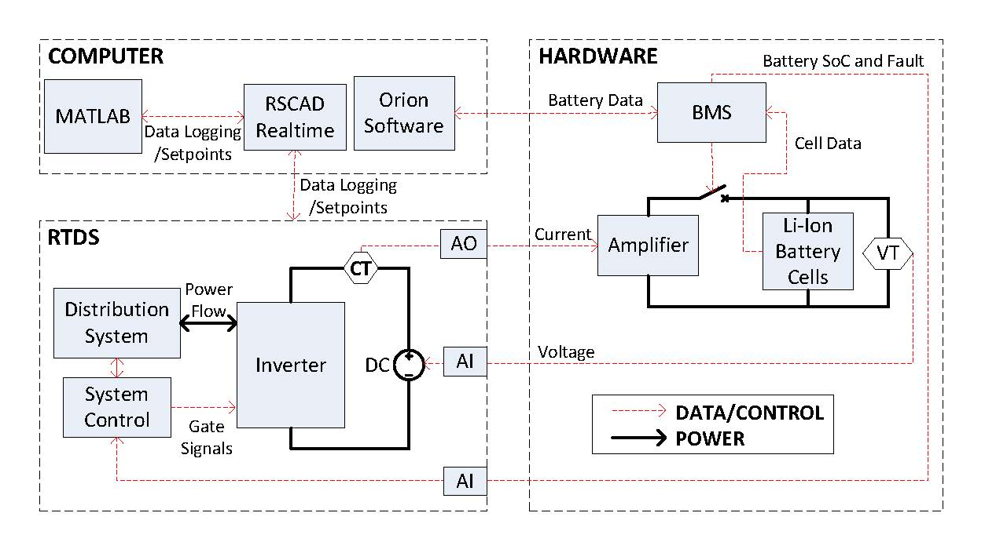
Power Hardware-in-Loop Battery Test System
Setup Design
Setup includes four main components: (1) The distribution feeder simulated in RTDS. (2) A four-quadrant inverter model serving as the interface between the BESS on the DC side and the distribution grid on the AC side. (3) A battery pack consisting of multiple battery cells, a battery management system (BMS), and accessories in hardware. (4) An energy manager computing unit with optimization software, for optimizing BESS operation implanted on a PC.
Communication and Data Flow Diagram of the P-HIL simulation testbed

Slide 7
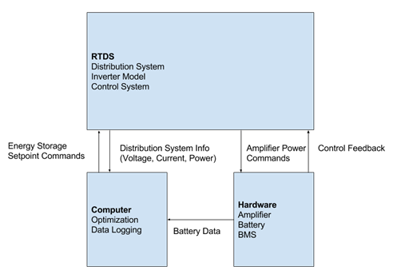
Power Hardware-in-Loop Battery Test System
Setup Design
Setup includes four main components: (1) The distribution feeder simulated in RTDS. (2) A four-quadrant inverter model serving as the interface between the BESS on the DC side and the distribution grid on the AC side. (3) A battery pack consisting of multiple battery cells, a battery management system (BMS), and accessories in hardware. (4) An energy manager computing unit with optimization software, for optimizing BESS operation implanted on a PC.
High-level Block Diagram of the Testbed

Slide 8
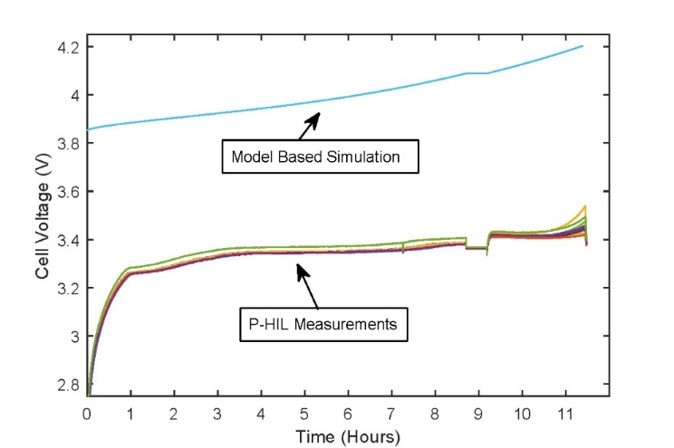
Power Hardware-in-Loop Battery Test System
Testbed Results
Testbed provides measurements on: (1) Non-linear voltage profile of the battery pack during charge and discharge operations (2) voltage characteristics of the individual cells; (3) cell and ambient temperature; (4) Errors in SoC estimation and their impacts; (5) The balancing current drawn from individual cells by the BMS.
Comparison: Physical Measurements Vs Model-based Simulation

Slide 9
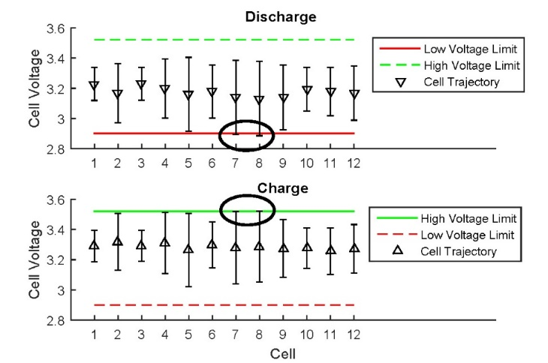
Power Hardware-in-Loop Battery Test System
Testbed Results
Testbed provides measurements on: (1) Non-linear voltage profile of the battery pack during charge and discharge operations (2) voltage characteristics of the individual cells; (3) cell and ambient temperature; (4) Errors in SoC estimation and their impacts; (5) The balancing current drawn from individual cells by the BMS.
Cell Voltages in Comparison with the Maximum and the Minimum Cell Voltage Limits

Slide 10
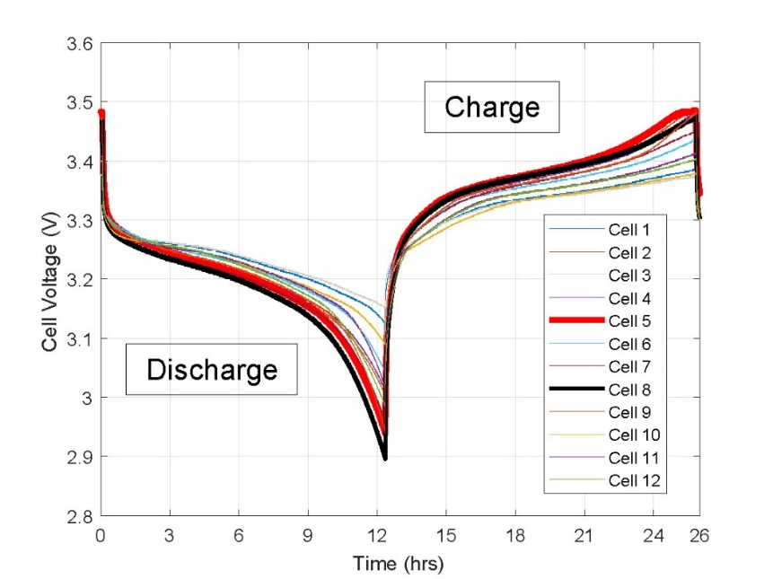
Detailed Modeling of Batteries in Optimal
Battery Energy Storage System Operation
About
We propose approaches to overcome the complexities of detailed modelling of batteries in BESS operation optimization. Features such as cell-to-cell variations in (a) maximum capacity, (b) charge level balance, and (c) internal resistance are addressed. We account for the individual cells forming the battery pack via equivalent circuit representation of each cell.
Energy Relevance
Construct and test a battery model for scheduling operation of grid connected BESS.
The battery modelling approach features event-based calibration, making the parameter estimation and updating non-intrusive.
A rigorous mathematical analysis to formulate grid-integration BESS optimization problems.

Slide 11
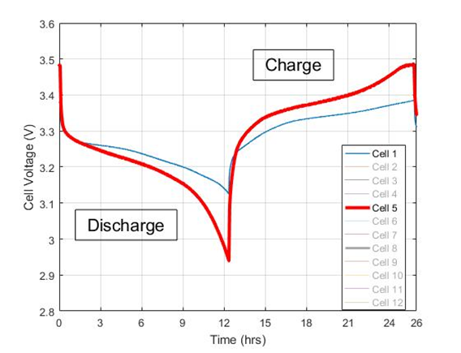
Detailed Modeling of Batteries in Optimal
Battery Energy Storage System Operation
About
We propose approaches to overcome the complexities of detailed modelling of batteries in BESS operation optimization. Features such as cell-to-cell variations in (a) maximum capacity, (b) charge level balance, and (c) internal resistance are addressed. We account for the individual cells forming the battery pack via equivalent circuit representation of each cell.
Energy Relevance
Construct and test a battery model for scheduling operation of grid connected BESS.
The battery modelling approach features event-based calibration, making the parameter estimation and updating non-intrusive.
A rigorous mathematical analysis to formulate grid-integration BESS optimization problems.

Slide 12
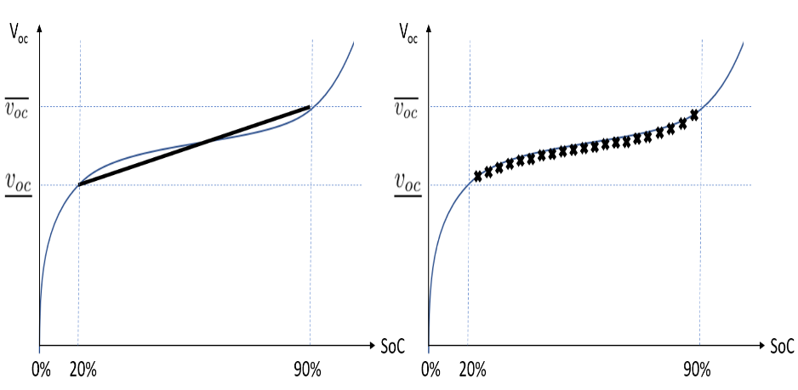
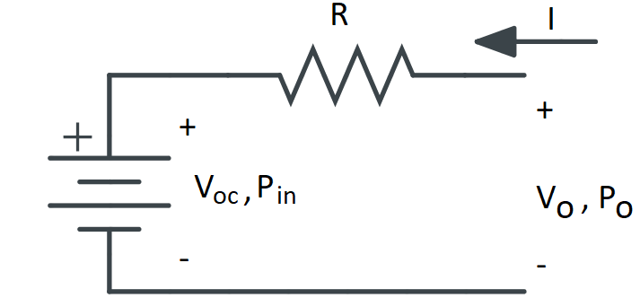
Detailed Modeling of Batteries in Optimal
Battery Energy Storage System Operation
Circuit Based Battery Optimization Model
The Battery presents a non uniform characteristics during a course of a cycle.
This leads to error in estimation of battery SoC, particularly at different discharge rates.
New formulation for BESS optimization to include the impact of non-linear battery model in form of a circuit based model with open circuit voltage characteristics.

Slide 13
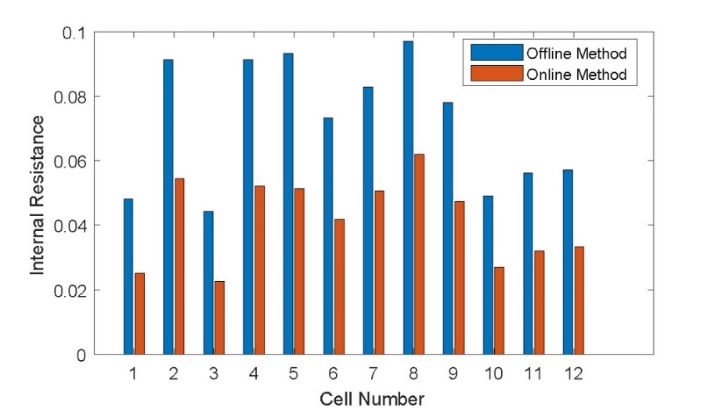

Detailed Modeling of Batteries in Optimal
Battery Energy Storage System Operation
Battery Model Real-time Parameter Estimation
Internal Resistance
2 approach to estimate cell internal resistance
Offline, (testing operational cycles) and
Online (during the typical daily operation)

Slide 14
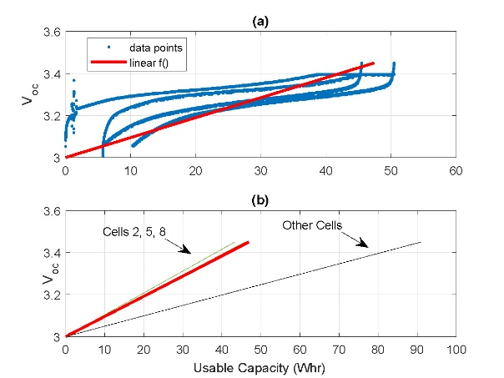
Detailed Modeling of Batteries in Optimal
Battery Energy Storage System Operation
Battery Model Real-time Parameter Estimation
OCV Characteristic
The Battery OCV characteristics is estimated by applying a regression model.
Leverage the knowledge of the cells’ maximum voltages and minimum voltages at fully charged and fully depleted cells, given in the manufacturer data sheet.

Slide 15
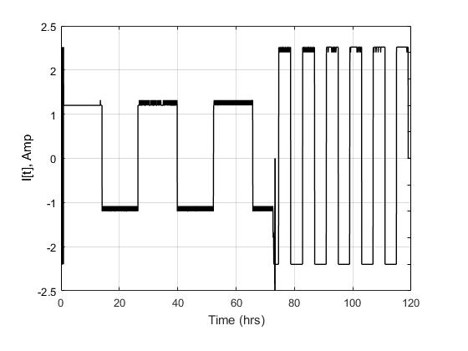
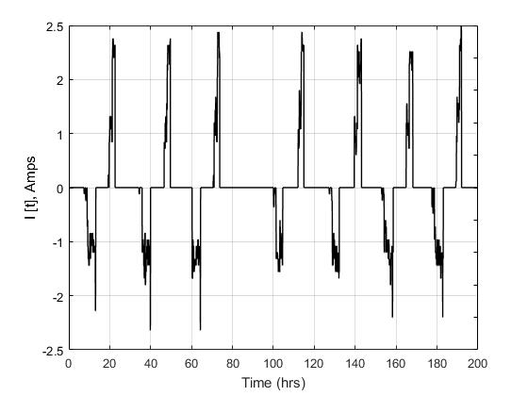
Detailed Modeling of Batteries in Optimal
Battery Energy Storage System Operation
HIL experiments
BESS operation test 1 for model estimation
Simple Full Cycles
BESS operation test 2 for model estimation
Typical Daily Operation Cycles

Slide 16
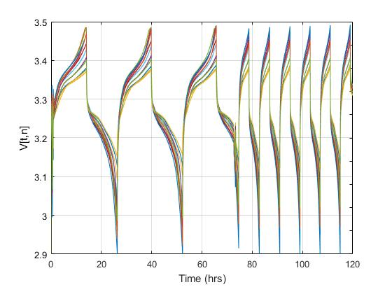
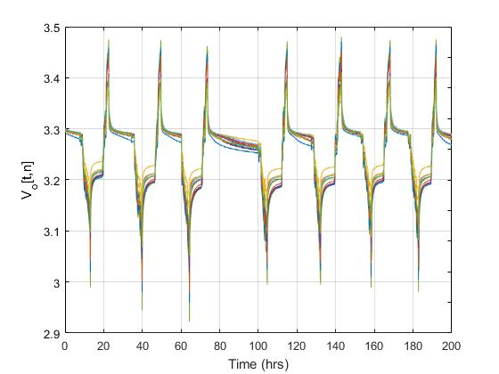
Detailed Modeling of Batteries in Optimal
Battery Energy Storage System Operation
HIL experiments
BESS operation test 1 for model estimation
Simple Full Cycles
BESS operation test 2 for model estimation
Typical Daily Operation Cycles

Slide 17
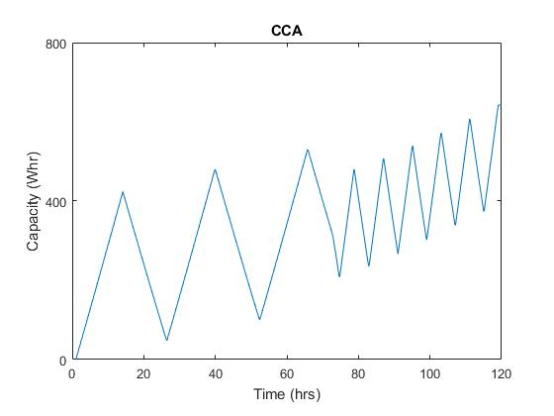
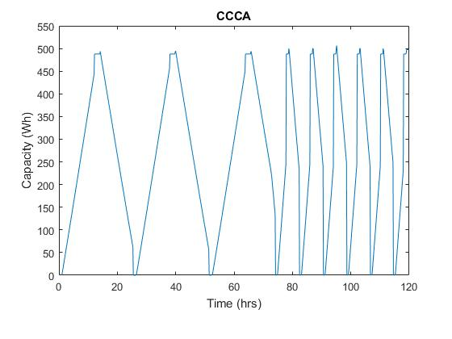
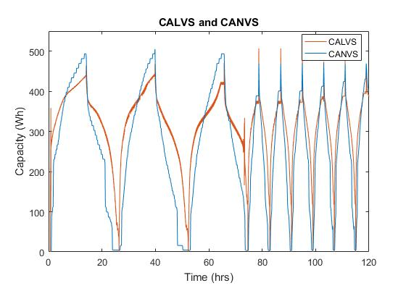
Detailed Modeling of Batteries in Optimal
Battery Energy Storage System Operation
HIL experiments
Battery SoC estimation
Baseline Model 1
Battery SoC estimation
Baseline Model 2
Battery SoC estimation
improved models (1) and (2)

Slide 18
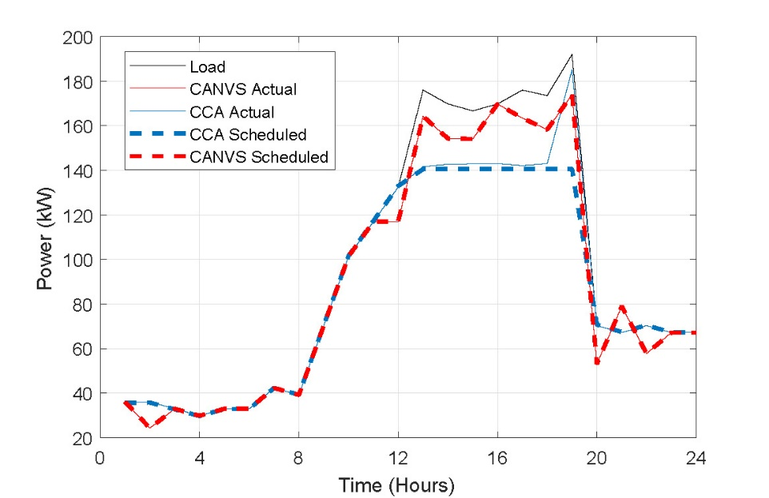
Detailed Modeling of Batteries in Optimal
Battery Energy Storage System Operation
Model Validation Experiment
The Simple model based on Coulomb counting has errors in estimation, hence more aggressively utilize the battery. This leads to a halt at hour 19.
The circuit based approach has a more accurate estimate of the battery available charge, thus chooses a higher target peak shaving threshold, and succeeds to achieve the threshold.

Slide 19
Detailed Modeling of Batteries in Optimal
Battery Energy Storage System Operation
Summary
The battery model inaccuracies can lead to performance losses in critical times
We develop a testbed to examine the practical features of BESS operation
The proposed model considers the battery device-level construct and more accurate models of the battery cells
We show the advantage in a PHIL test experiment

Slide 20
Thanks for Your Attention

